Slide 1
Recurrent Neural Network
Presentor: Krish C Naik

Slide 2
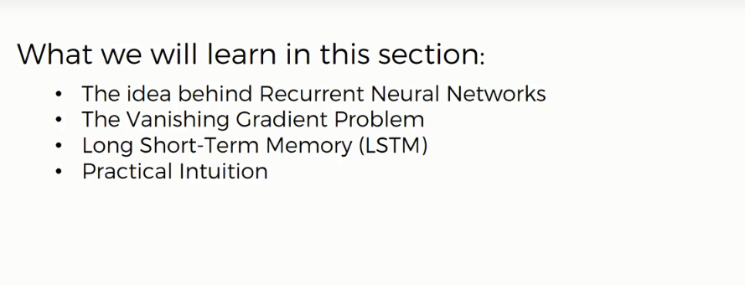
Recurrent Neural Network

Slide 3
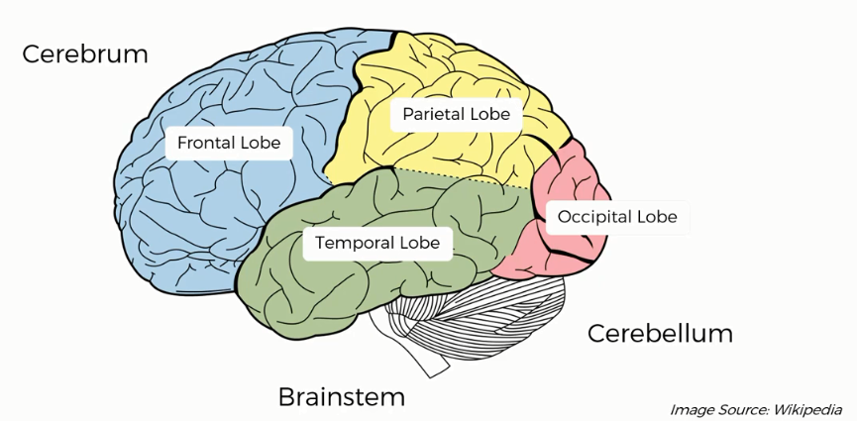
Recurrent Neural Network

Slide 4
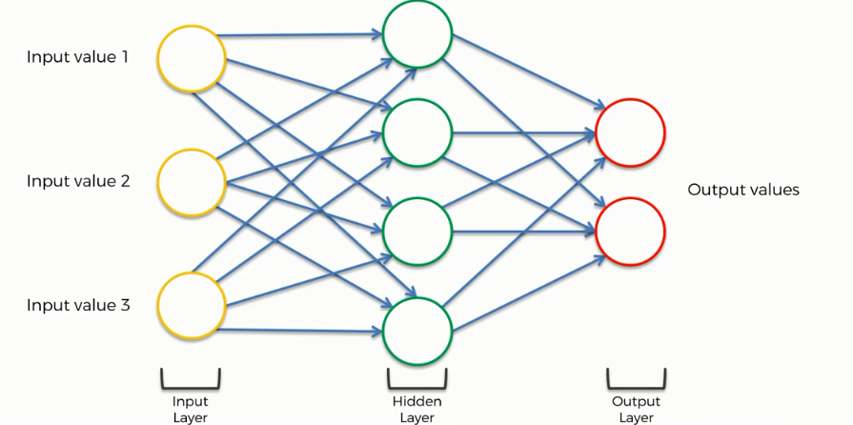
Recurrent Neural Network

Slide 5
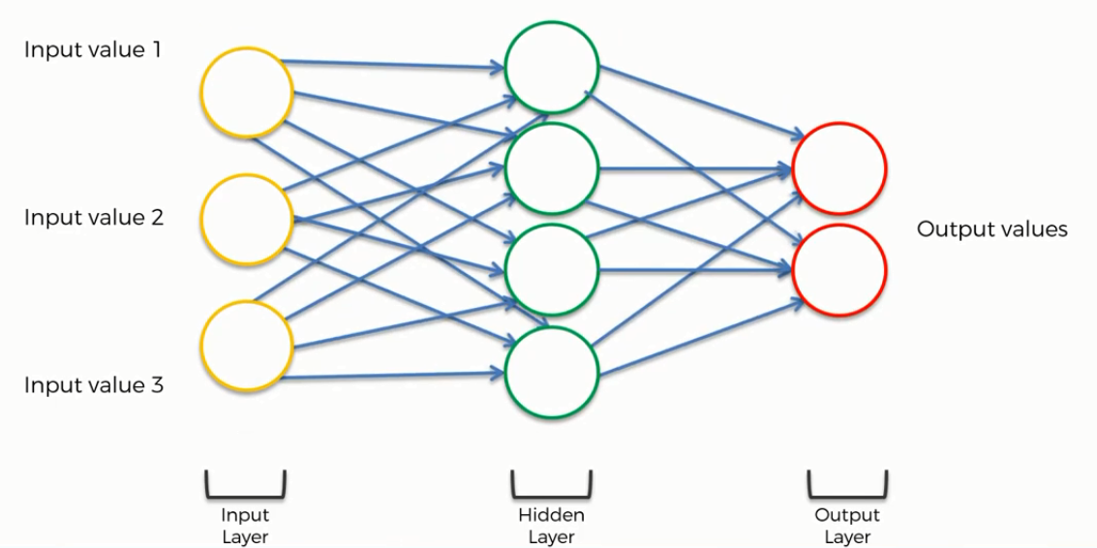
Recurrent Neural Network

Slide 6
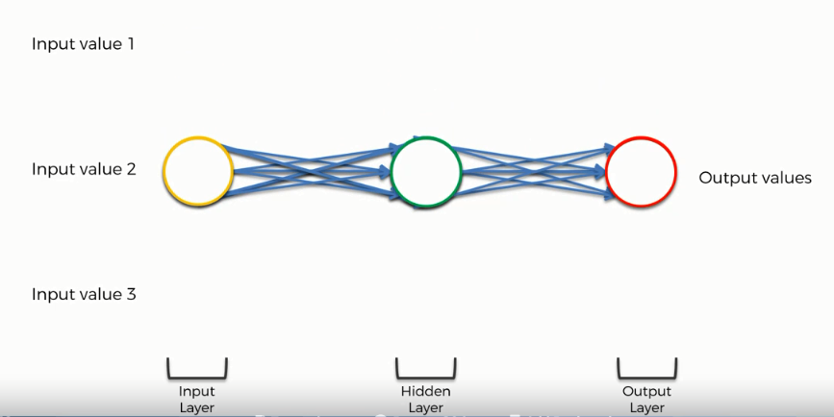
Recurrent Neural Network

Slide 7
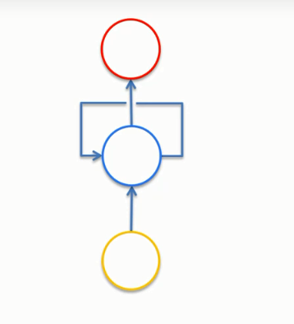
Recurrent Neural Network

Slide 8
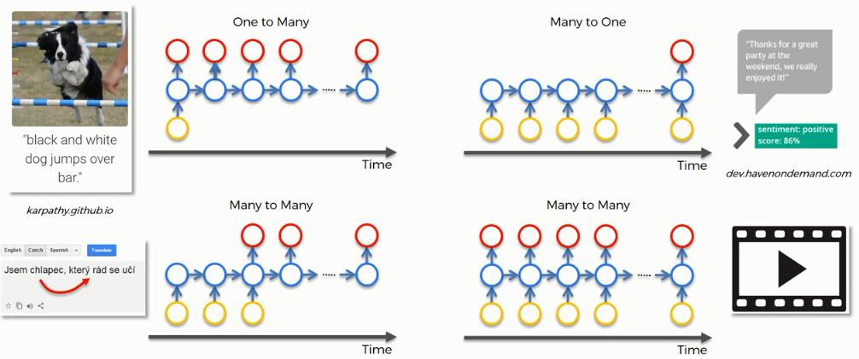
Recurrent Neural Network

Slide 9
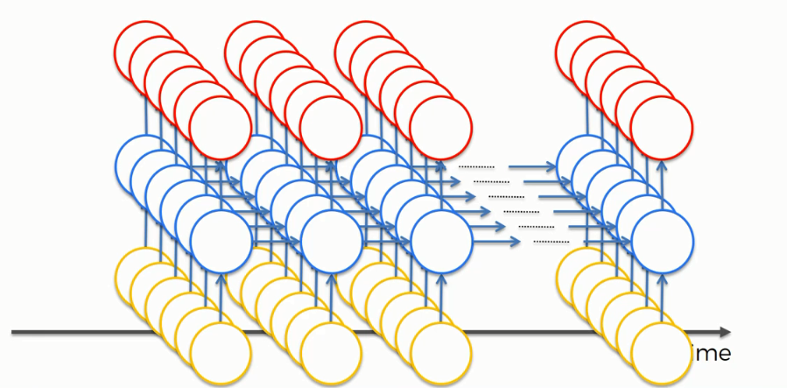

Slide 10

Recurrent Neural Network

Slide 11
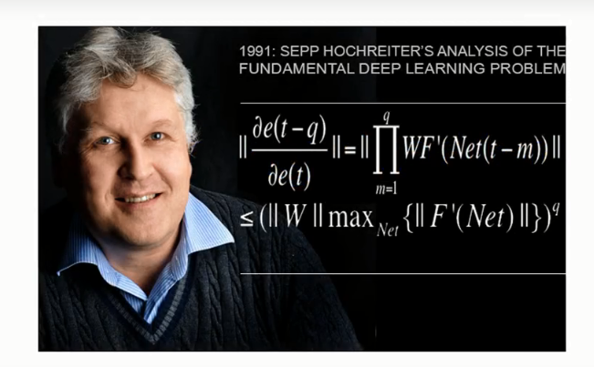
Vanishing Gradient

Slide 12
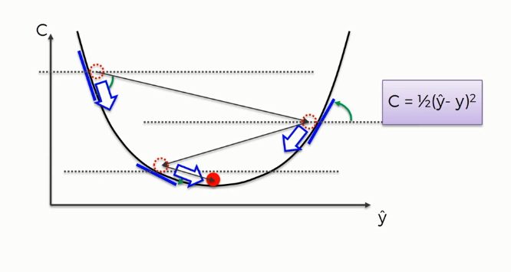
Gradient Descent

Slide 13
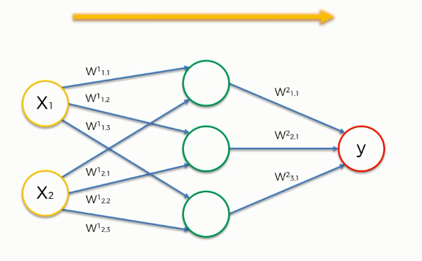
Recurrent Neural Network

Slide 14
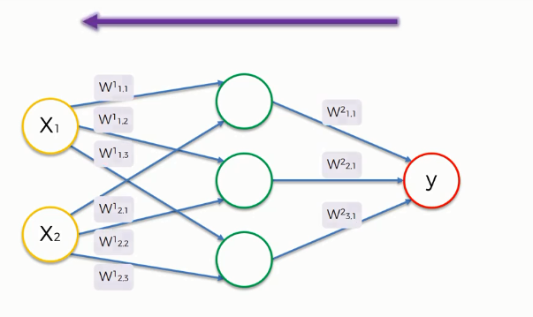
Recurrent Neural Nework

Slide 15
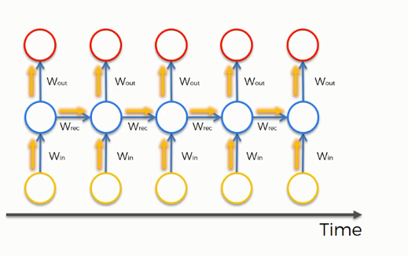
Recurrent Neural Network

Slide 16
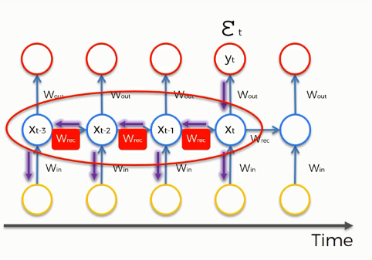
Recurrent Neural Network

Slide 17
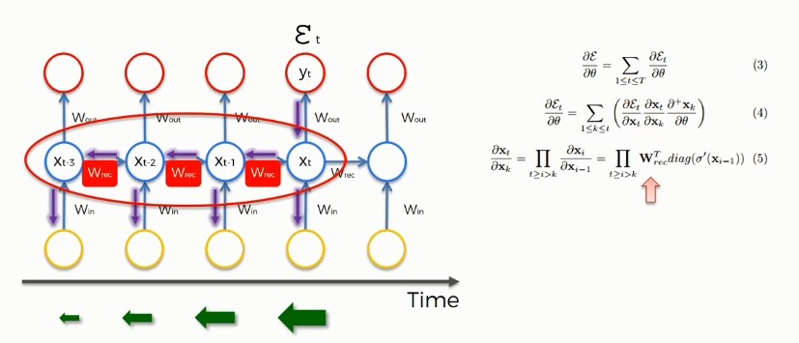
Vanishing Gradient

Slide 18
Long Short Term Memory
https://stats.stackexchange.com/questions/181/how-to-choose-the-number-of-hidden-layers-and-nodes-in-a-feedforward-neural-netw
https://www.youtube.com/watch?v=5Vl-bK7tfD8&list=PLBAGcD3siRDittPwQDGIIAWkjz-RucAc7
http://www.superdatascience.com/wp-content/uploads/2017/03/Convolutional-Neural-Networks.zip

Slide 19
https://www.youtube.com/watch?v=ArPaAX_PhIs&list=PLkDaE6sCZn6Gl29AoE31iwdVwSG-KnDzF

